Slide 1

RUNGTA COLLEGE OF DENTAL SCIENCES AND RESEARCH
CORONARY ARTERY DISEASE
DEPARTMENT OF GENERAL MEDICINE

Slide 2
SPECIFIC LEARNING OBJECTIVES
MUST KNOW | NICE TO KNOW | DESIRE TO KNOW
ETIOLOGY AND PATHOGENESIS | COLLATERAL CIRCULATION | HEALTH PROMOTION AND MAINTENANCE
CLINICAL MANIFESTATIONS | TYPES OF ANGINA
ANGINA

Slide 3
CONTENTS
Introduction
Etiology and pathogenesis
Collateral circulation
Clinical manifestations
Angina
Types of angina
Health promotion and maintenance
Summary

Slide 4
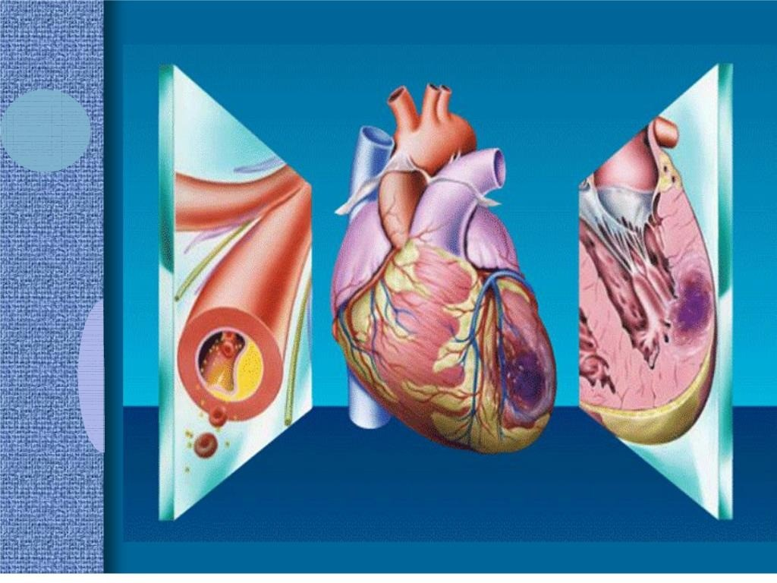

Slide 5
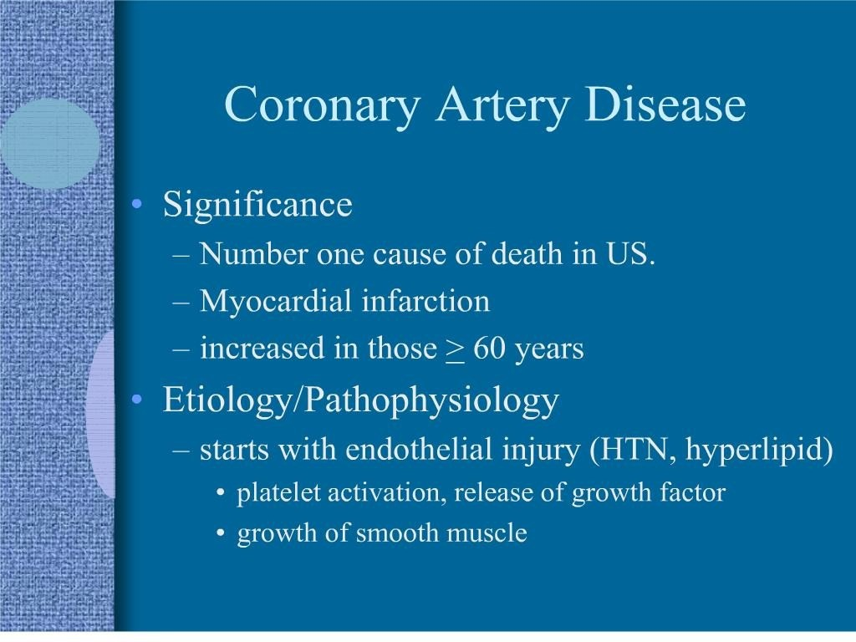

Slide 6
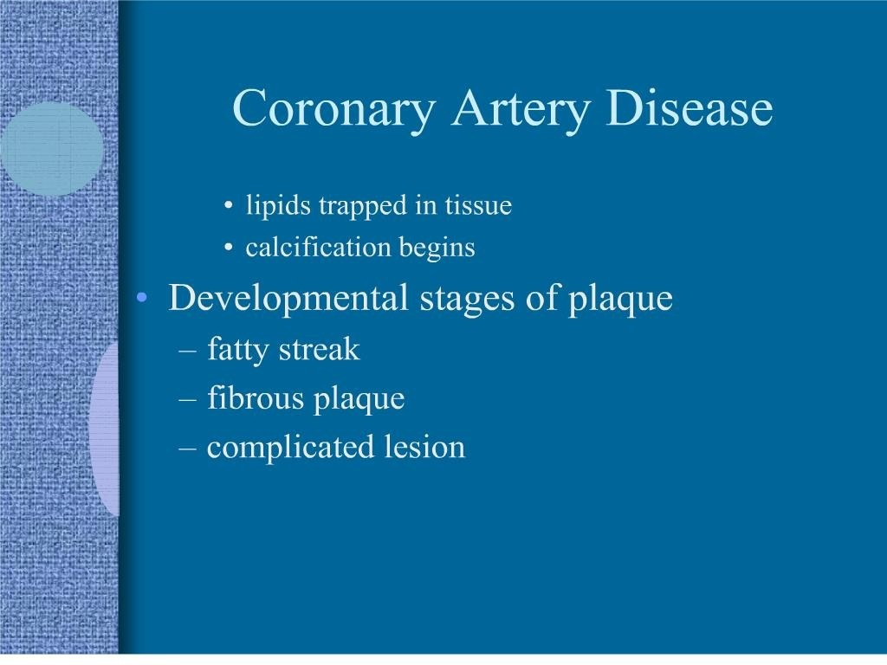

Slide 7
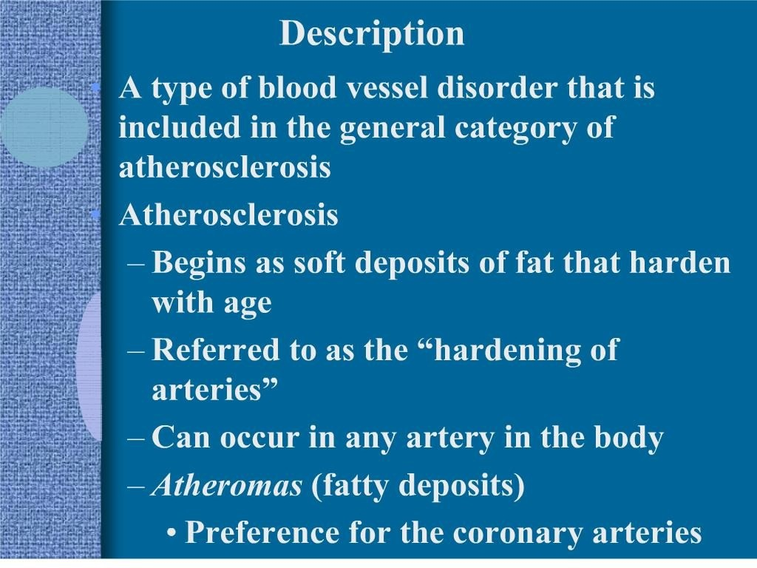

Slide 8
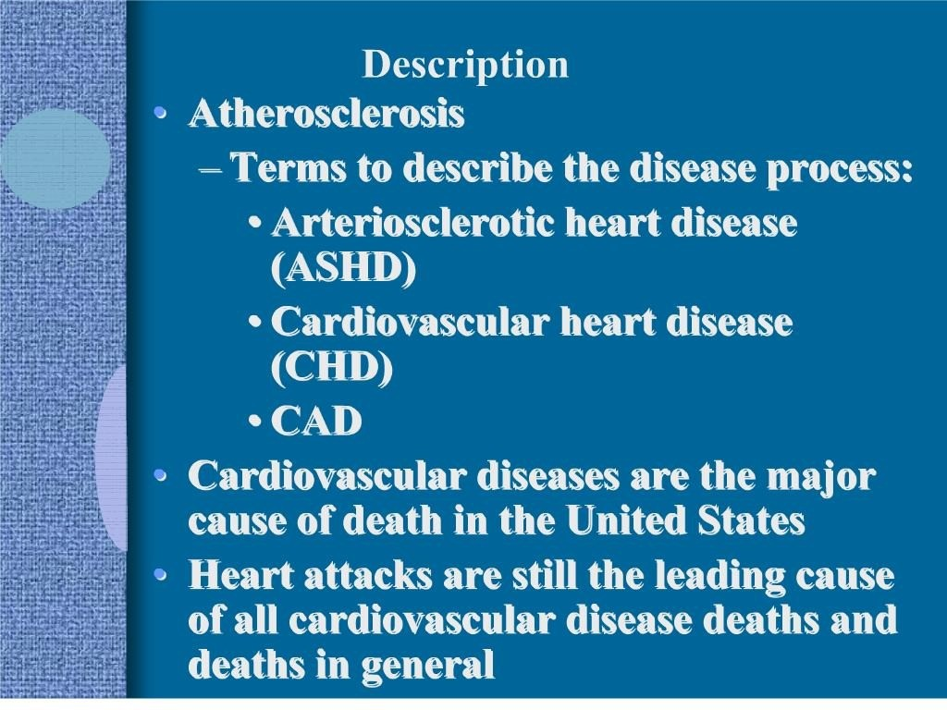

Slide 9
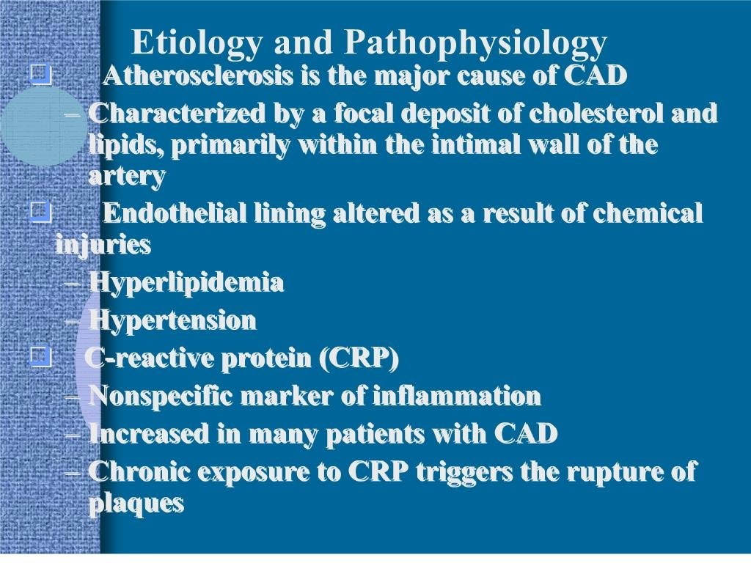

Slide 10
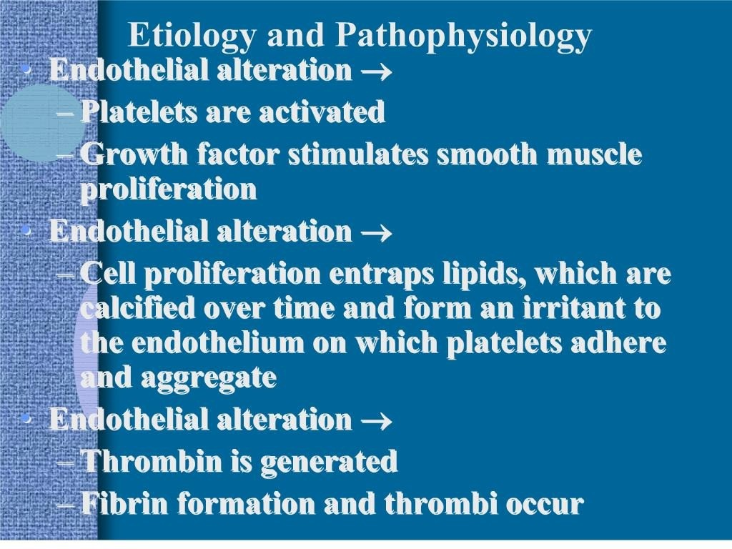

Slide 11
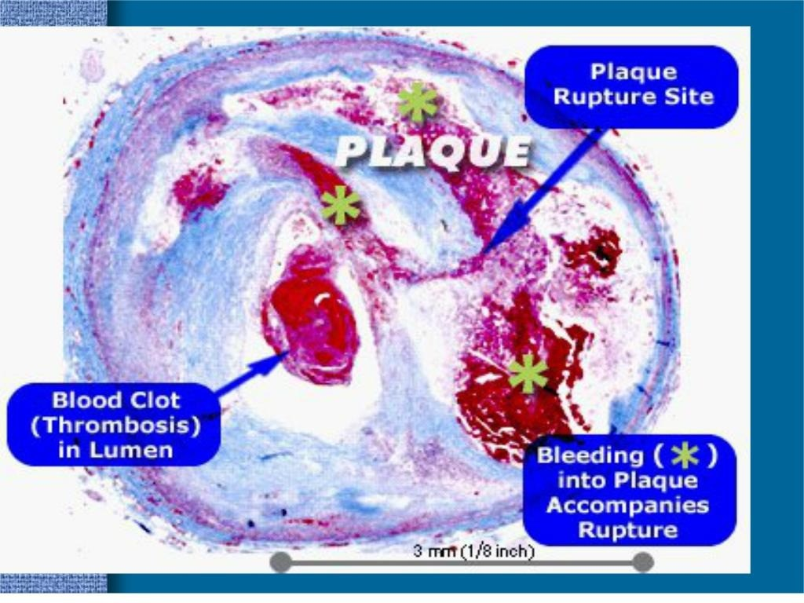

Slide 12
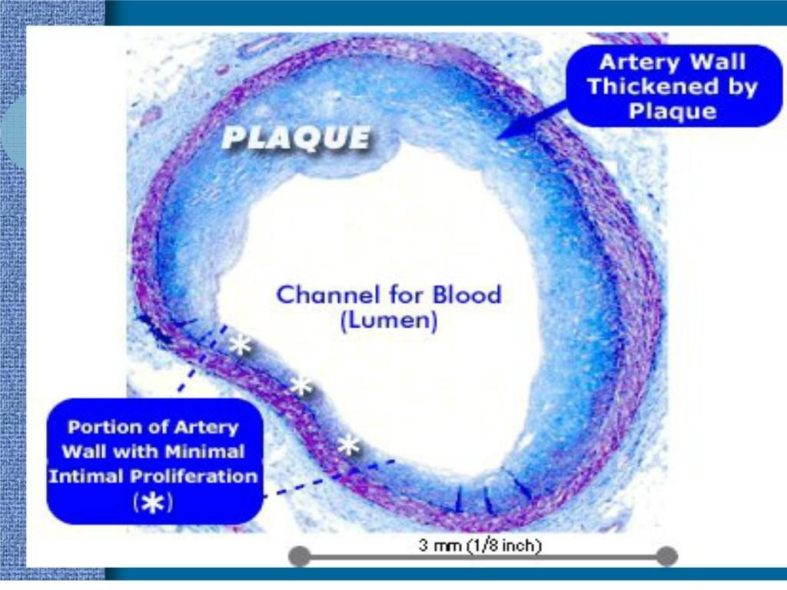

Slide 13
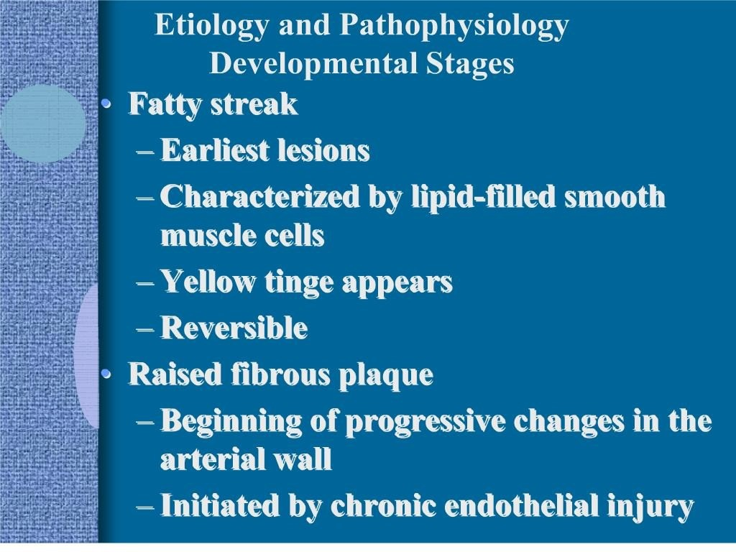

Slide 14
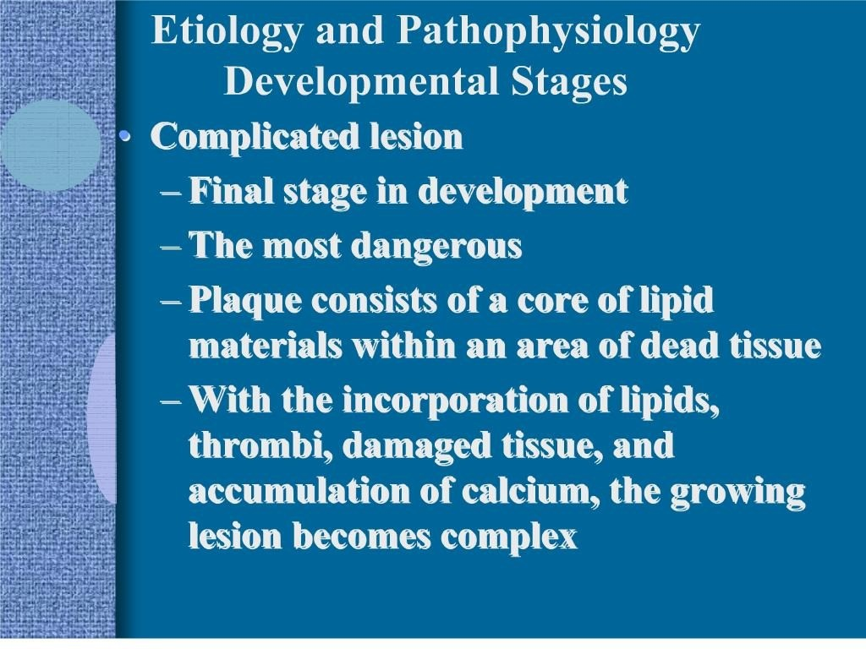

Slide 15
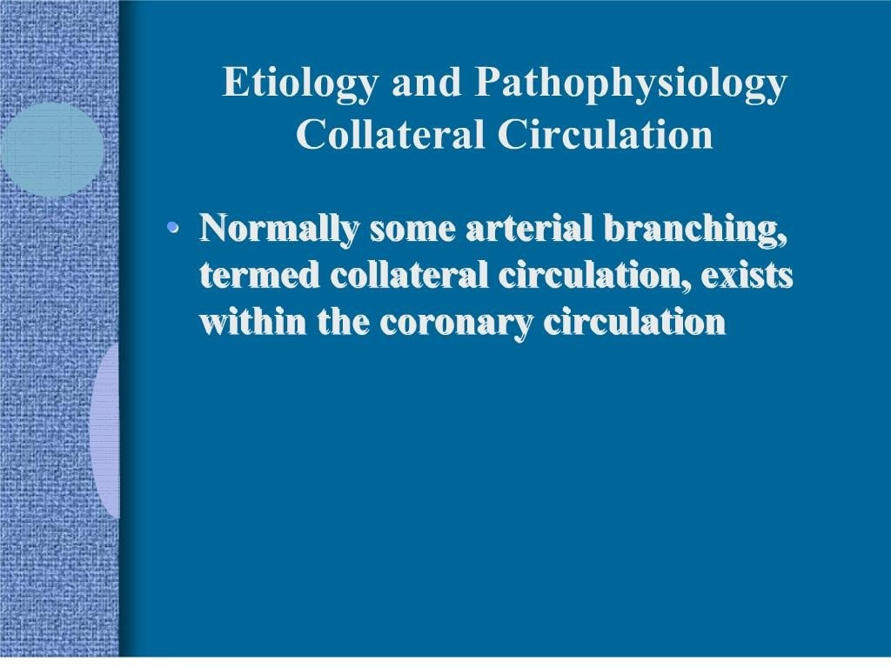

Slide 16
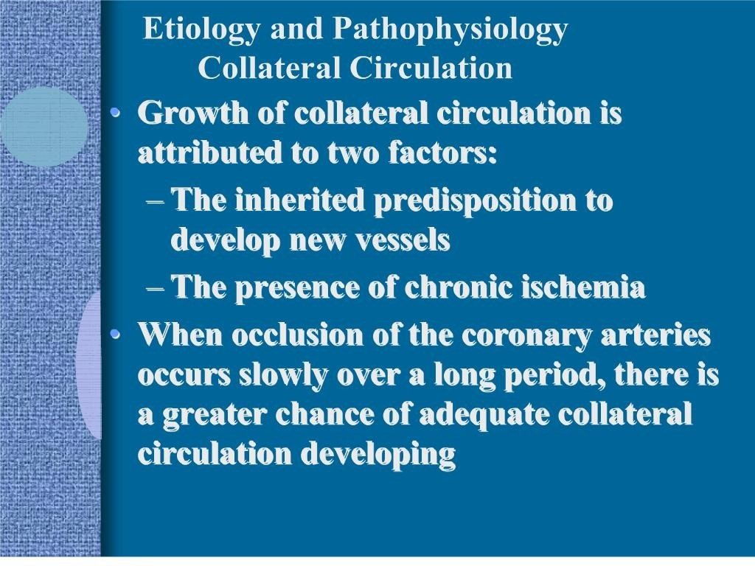

Slide 17
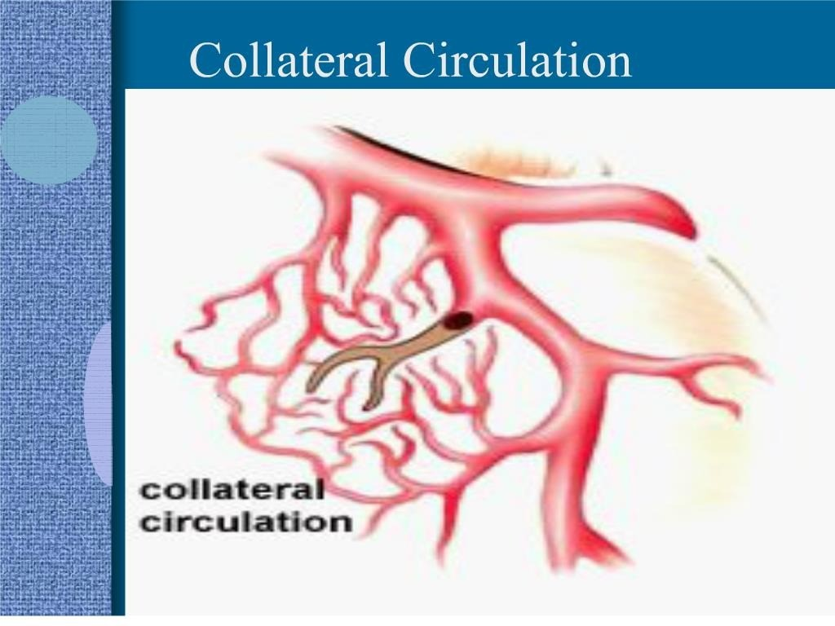

Slide 18
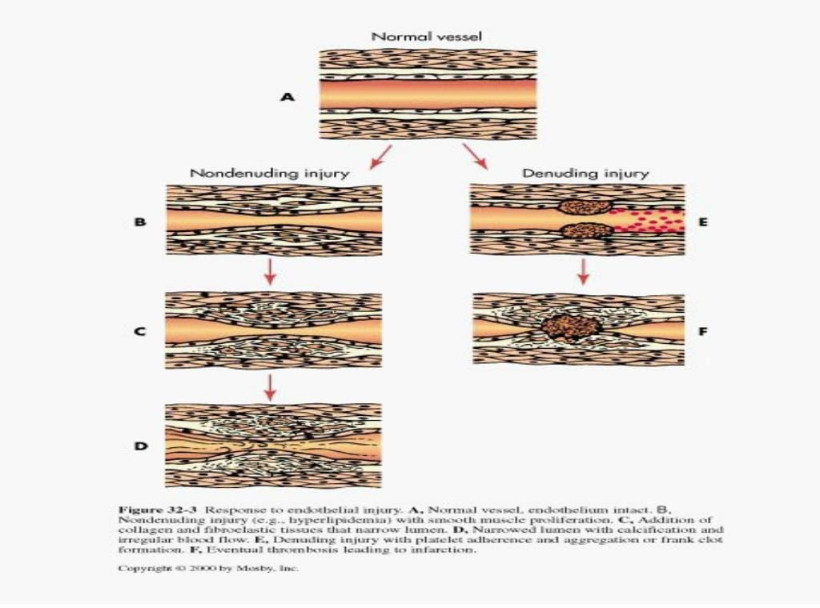

Slide 19
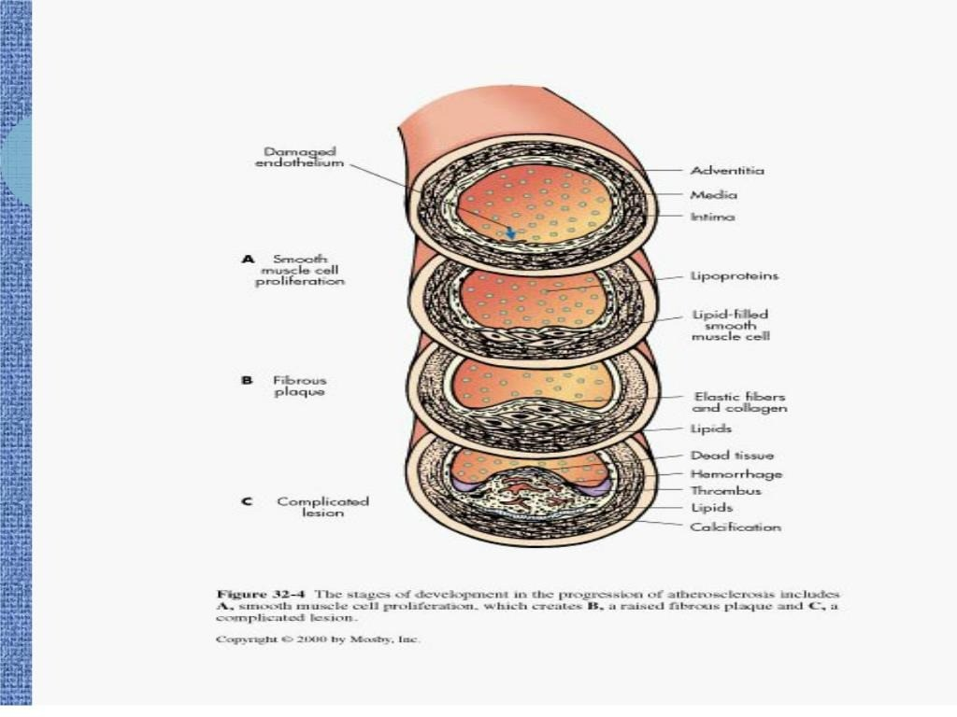

Slide 20
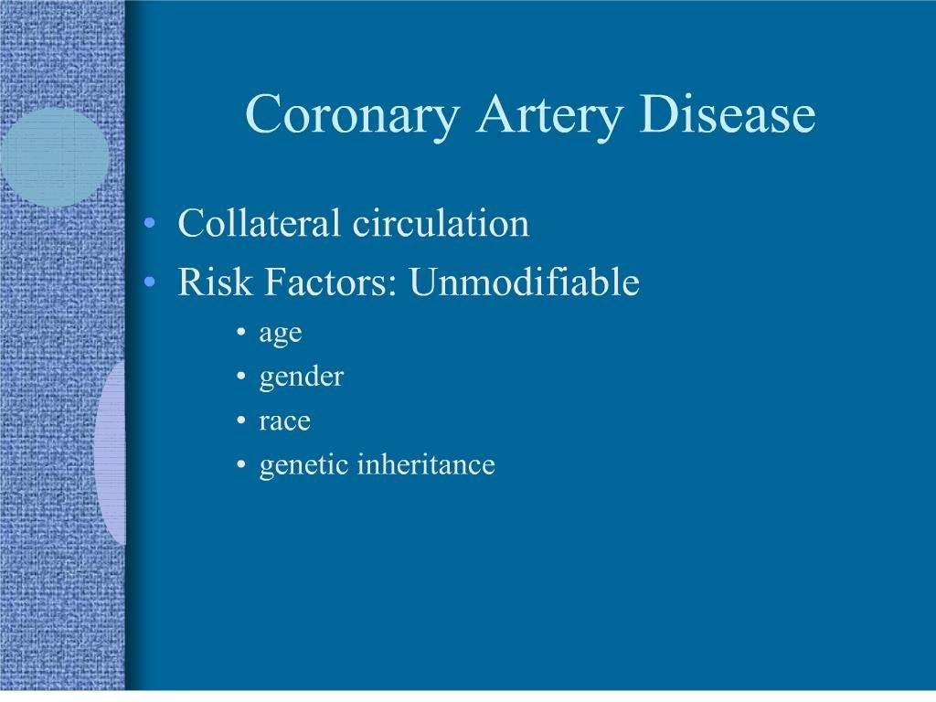

Slide 21
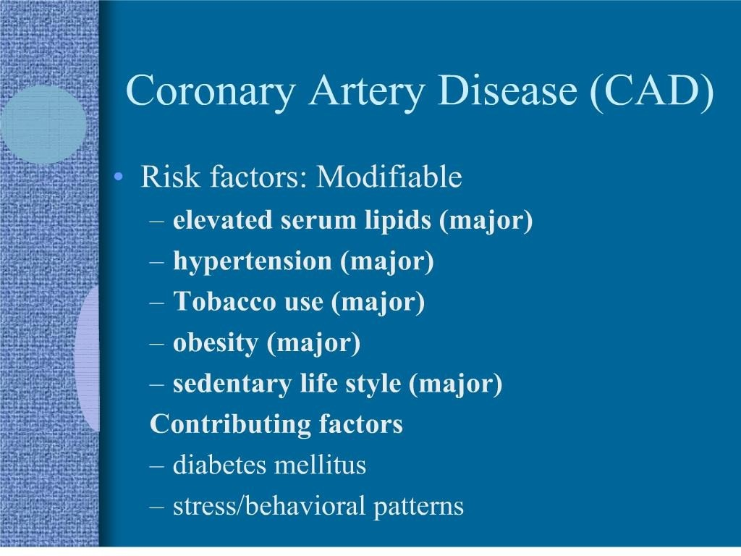

Slide 22
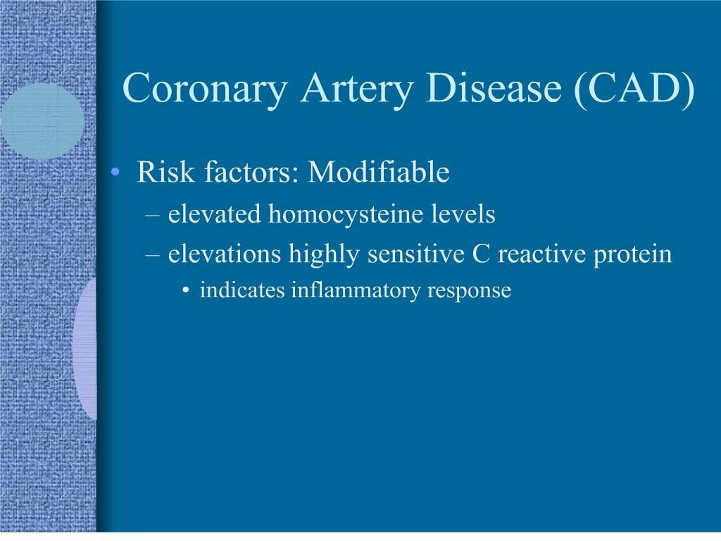

Slide 23
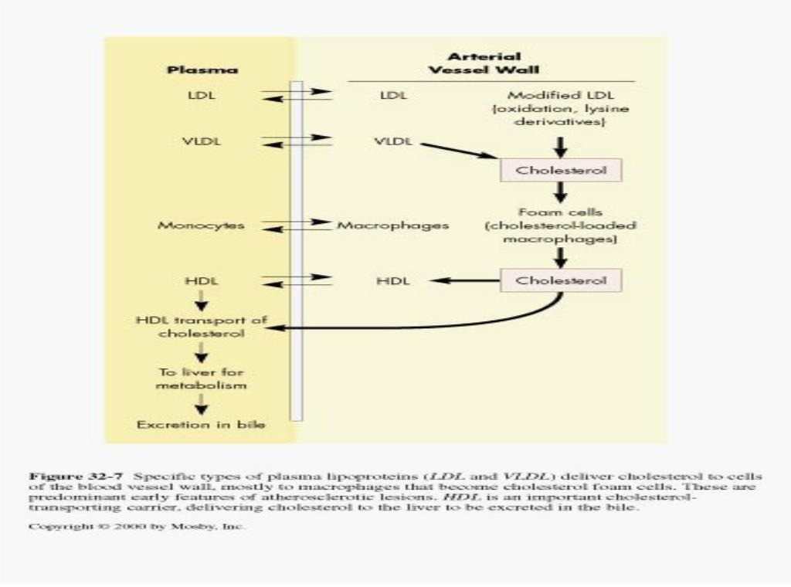

Slide 24
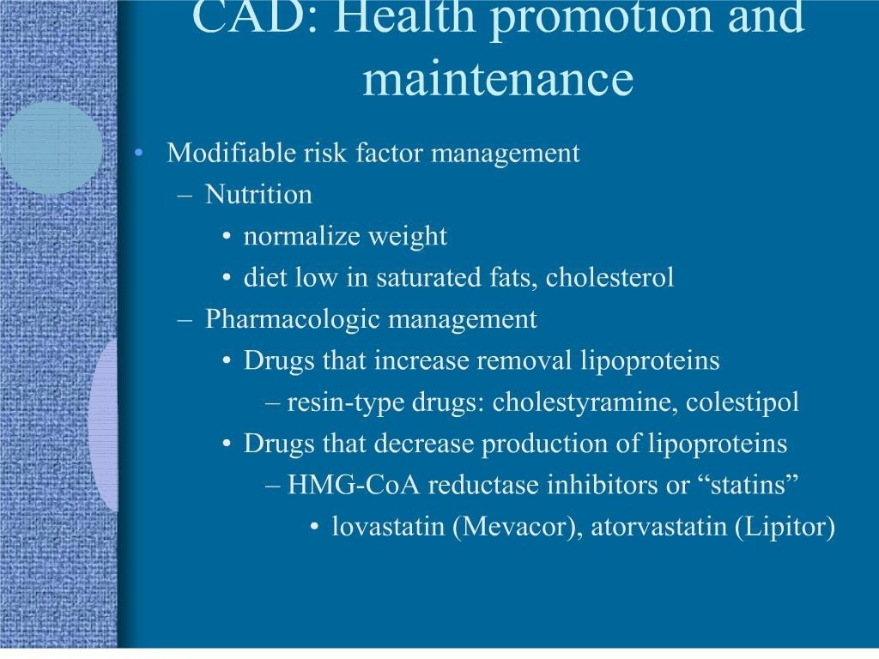

Slide 25
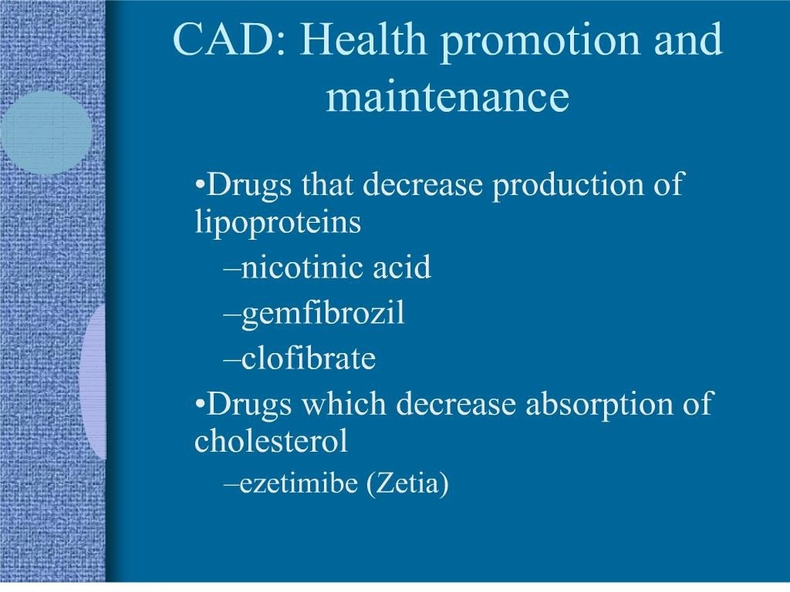

Slide 26
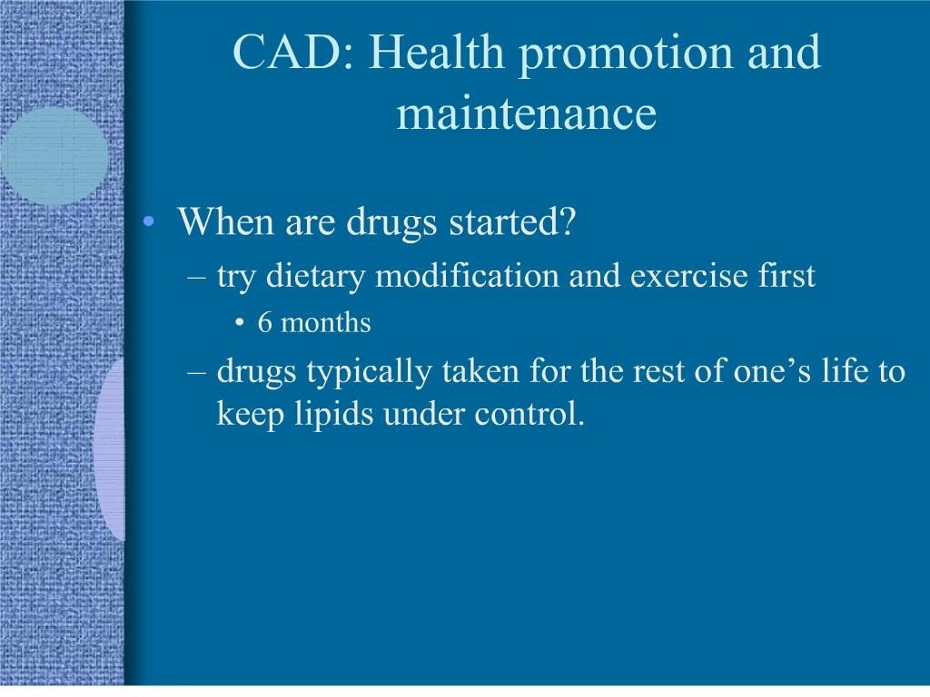

Slide 27
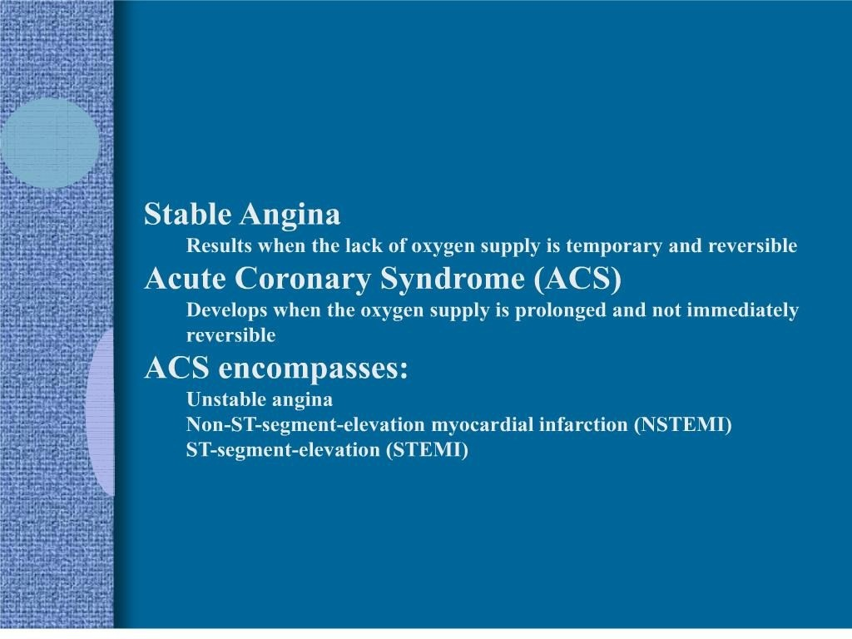

Slide 28
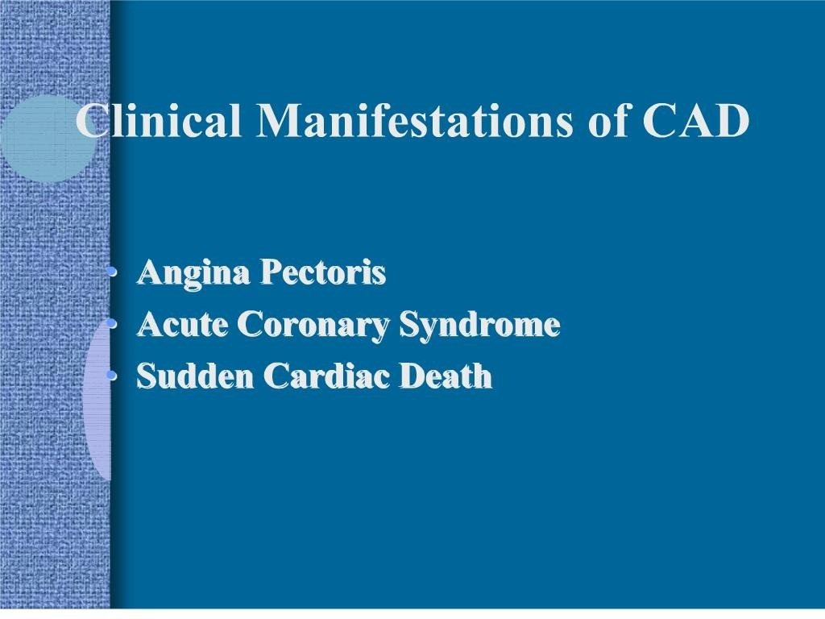

Slide 29
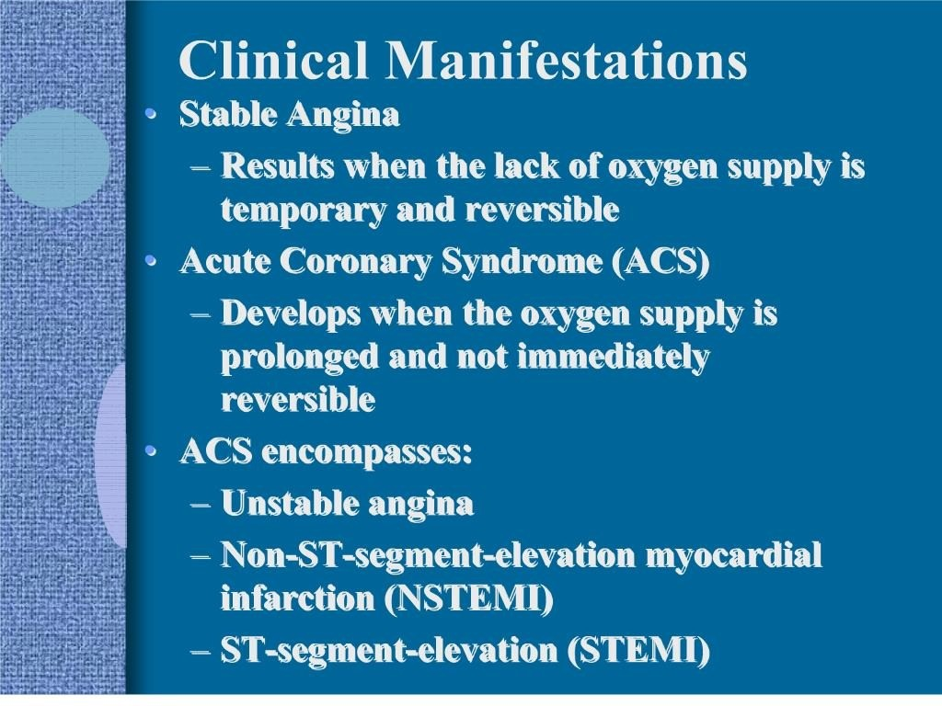

Slide 30
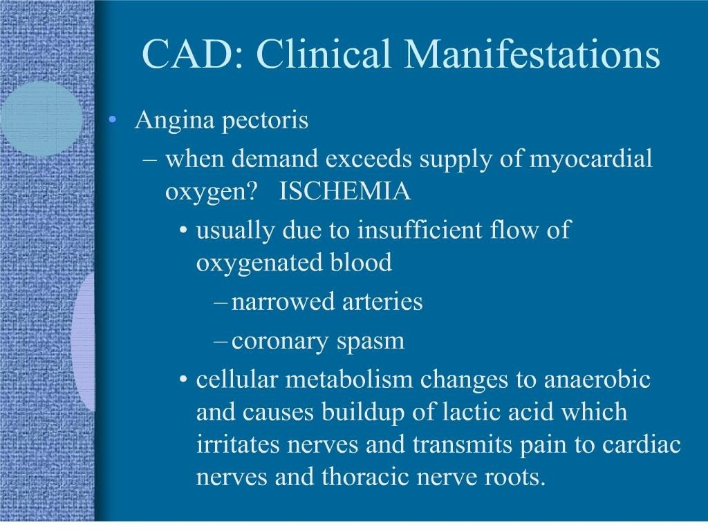

Slide 31
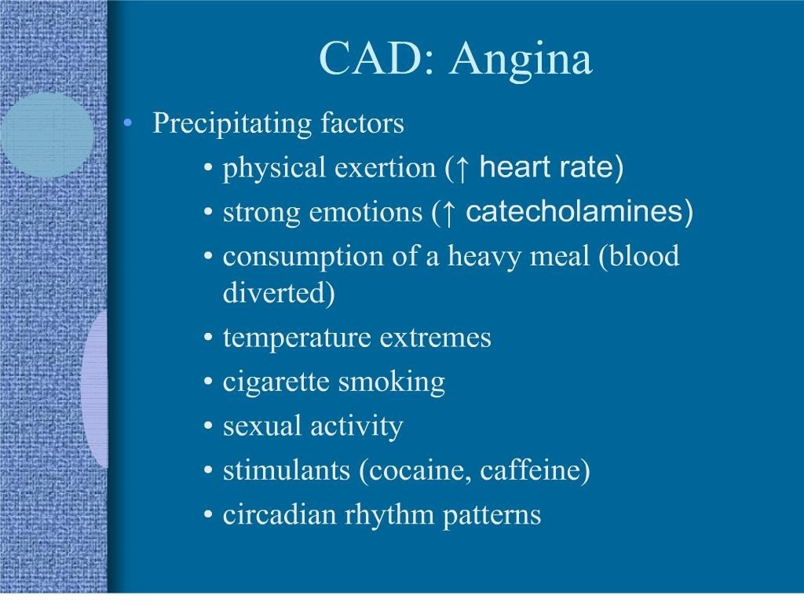

Slide 32
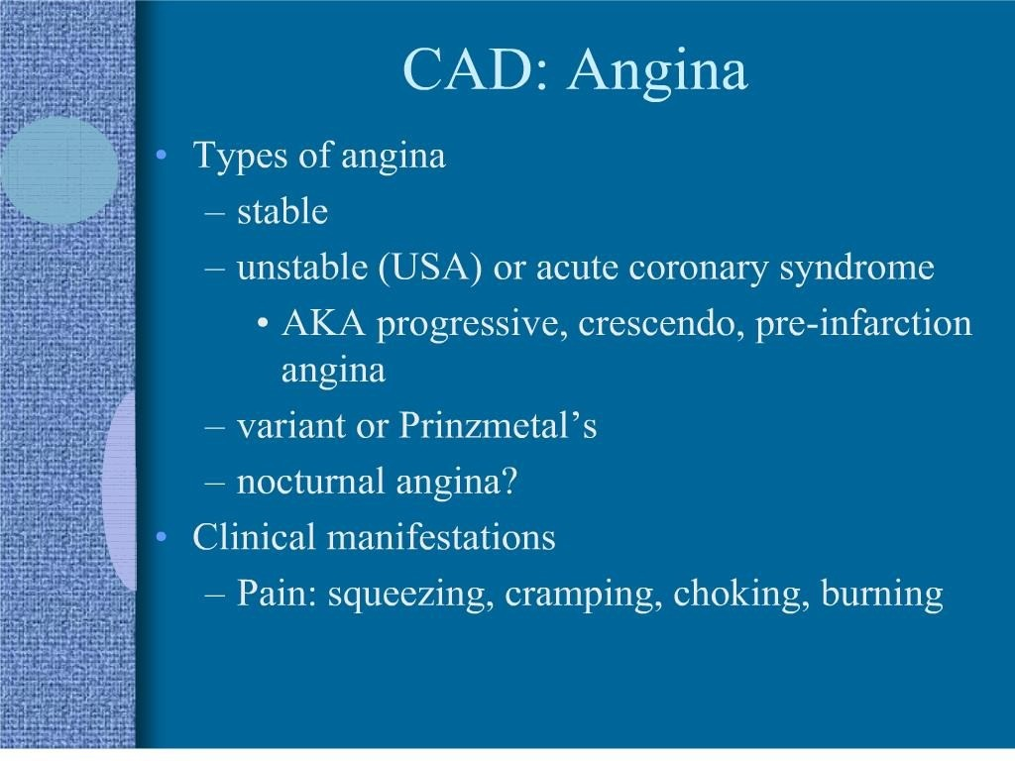

Slide 33
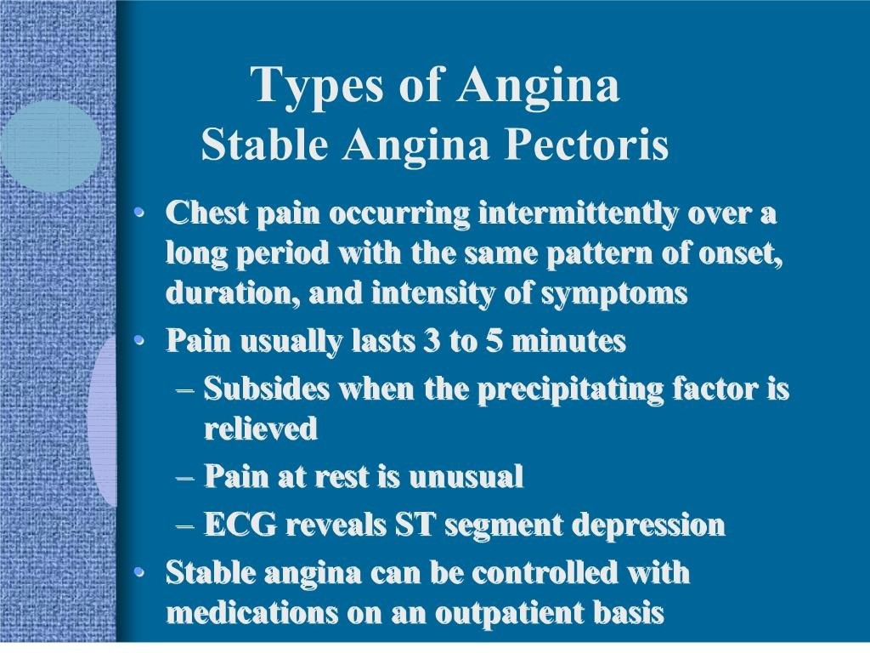

Slide 34
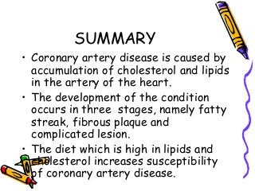

Slide 35
REFERENCES
DAVIDSON’S PRINCIPLES AND PRACTICE OF MEDICINE; 23rd edition
HARRISON’S PRINCIPLE OF INTERNAL MEDICINE; 21ST edition
TEXTBOOK OF CLINICAL MEDICINE by S.N Chugh ;5th edition

Slide 36
QUESTION AND ANSWERS

Slide 37
THANK YOU....

